Slide 1

A Gentle Introduction
to Causal Inference

Slide 2



The schedule for each session…
14:00 -- 14:10 Introduction and Motivations
14:10 -- 14:50 Presentation and Q&A
14:50 -- 15:00 10-minute Break
15:00 -- 15:45 Practical Session
15:45 -- 16:00 Final Wrap-Up
www.cdcs.ed.ac.uk

Slide 3

Welcome!
Chris Oldnall
www.cdcs.ed.ac.uk

Slide 4

Week 2:
Advanced Concepts and Estimation
www.cdcs.ed.ac.uk

Slide 5
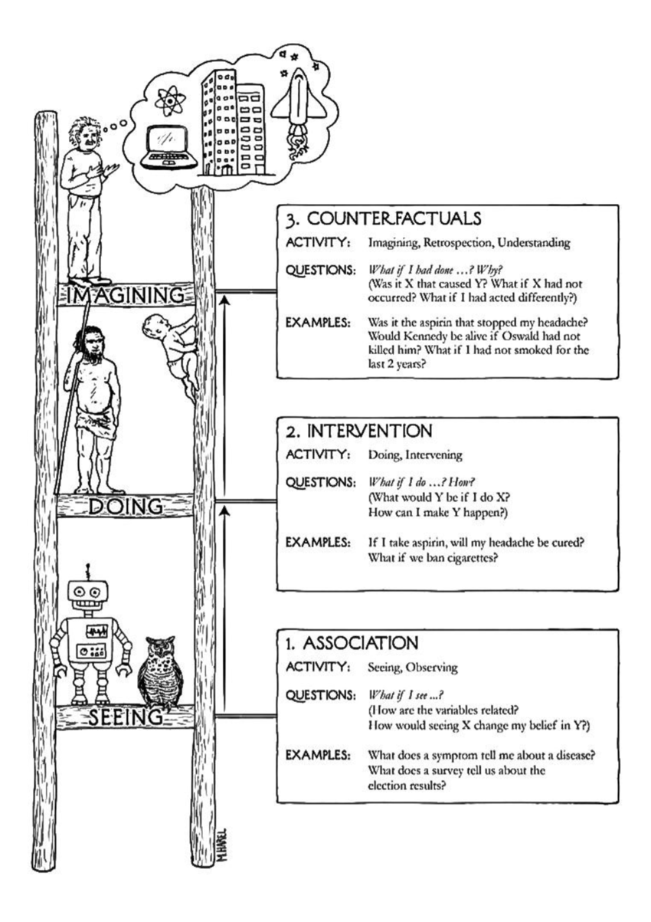
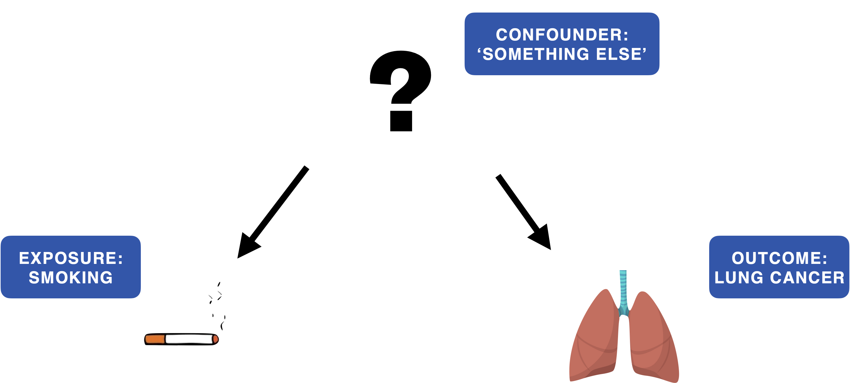
What did we look at last time?
Smoking in the multiverse of madness
www.cdcs.ed.ac.uk

Slide 6



The problem of confounding
Prior community engagement
Effect of funding on community engagement.
Funding for community engagement.
Engagement from the community.
www.cdcs.ed.ac.uk

Slide 7
The problem of confounding
If we simply compare communities with and without funding, we may overestimate the effect due to existing differences in community engagement.
Prior community engagement
Need for better methods to balance groups and make fair comparisons.
Effect of funding on community engagement.
Funding for community engagement.
Engagement from the community.
www.cdcs.ed.ac.uk

Slide 8
Stable unit treatment value assumption (SUTVA)
1. No interference – One unit’s treatment shouldn’t affect another’s outcome.
2. No multiple versions of treatment – The treatment must be well-defined.
The effect of social media bans on political activism:
If one group loses access to social media but mobilises through other means and influences another group’s activism, the assumption is violated.
www.cdcs.ed.ac.uk

Slide 9
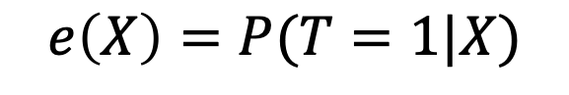
What is a propensity score?
The probability of receiving an intervention given a set of observed covariates.
$$e\left(X\right)=P(T=1|X)$$
Creates comparable groups without needing randomisation.
Reduces confounding by balancing covariates.
www.cdcs.ed.ac.uk

Slide 10
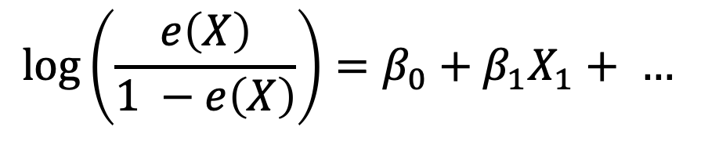
How do we estimate a propensity score?
Logistic Regression: Predicts treatment assignment based on covariates.
Machine Learning Approaches such as Decision Trees, Random Forests, Neural Networks exist and are more flexible but require careful tuning.
$$\log\left(\frac{e\left(X\right)}{1 −e\left(X\right)}\right)=β_{0}+β_{1}X_{1}+ …$$
www.cdcs.ed.ac.uk

Slide 11
Using propensity scores for matching.
Matching Method: Each treated unit is paired with a control unit having a similar propensity score.
Steps:
Estimate propensity scores.
Match treated and untreated units.
Assess balance and estimate the causal effect.
www.cdcs.ed.ac.uk

Slide 12
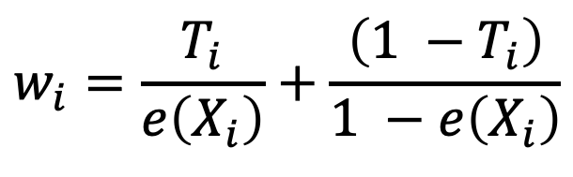
Inverse probability of treatment weighting (IPTW)
Instead of discarding data (like matching), IPTW reweights observations.
$$w_{i}=\frac{T_{i}}{e\left(X_{i}\right)}+\frac{\left(1 −T_{i}\right)}{1 −e\left(X_{i}\right)}$$
Effectively creates a pseudo-population that mimics randomisation.
www.cdcs.ed.ac.uk

Slide 13
Some key considerations on IPTW.
Advantages:
Uses full dataset.
More efficient than matching.
Disadvantages:
Sensitive to incorrect model specification.
Can create extreme weights
www.cdcs.ed.ac.uk

Slide 14
When do we use what methods to deal with confounding?
Method | Strengths | Weaknesses
Randomisation | Eliminates confounding. | Often infeasible with already collected data / not specifically collected.
Matching | Easy to interpret, removes extreme cases. | Data loss.
IPTW | Uses full data, handles complex confounding. | Sensitive to model misspecification
Instrumental Variables | Can handle unobserved confounding. | Hard to find valid instruments.
www.cdcs.ed.ac.uk

Slide 15
10 Minute Break

Slide 16
Practical Session 2
www.cdcs.ed.ac.uk

Slide 17
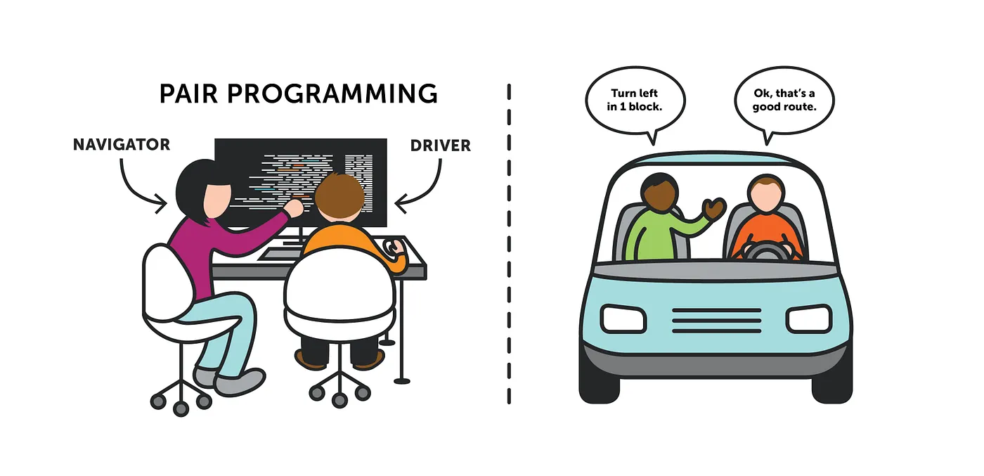
Image from: https://medium.com/@tomspencer_uk/pair-programming-and-problem-solving-4531ef3bf171
www.cdcs.ed.ac.uk

Slide 18
Pair Programming
find a partner
switch driver & navigator roles regularly, e.g., after every task in the notebook
you can work with the same partner throughout the course, or switch between sessions
ask us for help! (yes, even for small things)
www.cdcs.ed.ac.uk

Slide 19
Let’s get programming
For Python:
For R:
Go to https://noteable.edina.ac.uk/login
Login with your EASE credentials
Select RStudio as a personal notebook server and press start.
Go to File > New Project> Version Control > Git
Copy and Paste this repository URL https://github.com/DCS-training/IntroCausalInference as the Repository URL (The Project directory name will filled in automatically but you can change it if you want your folder in Notable to have a different name).
Decide where to locate the folder. By default, it will locate it in your home directory.
Press Create Project Congratulations you have now pulled the content of the repository on your Notable server space.
Go to https://noteable.edina.ac.uk/login
Login with your EASE credentials
Select 'Standard Notebook (Python3)' as a personal notebook server and press start
Click the '+GitRepo'
Copy and Paste this repository URL https://github.com/DCS-training/IntroCausalInference as the Repository URL - you do not need to add in any other fields.
Decide where to locate the folder. By default, it will locate it in your home directory
Press 'Clone' Congratulations you have now pulled the content of the repository on your Notable server space.
www.cdcs.ed.ac.uk

